Slide 1
Accreditation Process 2023-24
IEFA and Student Performance
Office of Public Instruction Staff
November 2023

Slide 2
Agenda
Welcome/Introductions
Fall Reporting Transition
Year 1 Plan
IEFA
Student Performance
Criteria Reference Guide
Resource and Guidance
Next Steps

Slide 3



Welcome/Introductions
Crystal Andrews
Director of Accreditation, Educator Preparation Programs, & Licensure
Ellery Bresler
Accreditation
Specialist
Michelle Price
Accreditation
Specialist

Slide 4


Welcome/Introductions
Zach Hawkins
Director of Indian Education for All
Mike Jetty
Indian Education Specialist

Slide 5
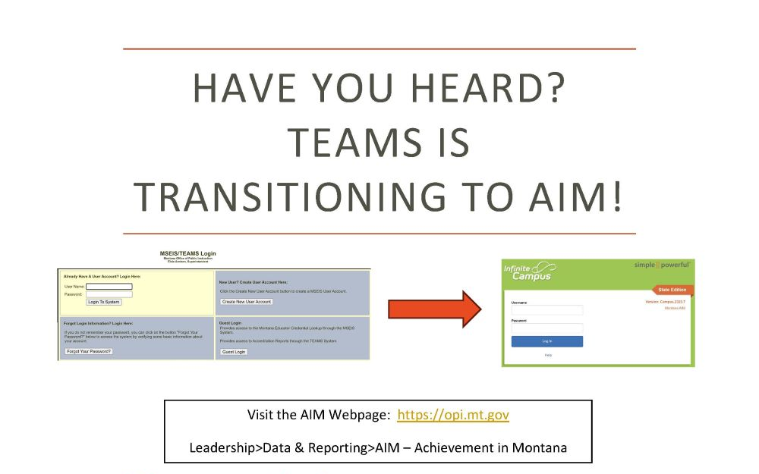
Visit the AIM Webpage for more information

Slide 6
Year 1- All Districts
Year 1- “Coach and Guide”
Focus on Support, Mechanisms and Methodology
Due: March 29th, 2024
ISAP Components | Assurance Standards | Student Performance Standards
CNA with Gap Analysis to set goals and academic programming Family and Community Engagement Plan Graduate Profile- a plan to show progress (2-3 action steps to meet graduate profile) no set template - districts have flexibility to individualize | General Assurances: School Leadership Academic Requirements | Proficiency, Progress and Growth: SBAC MAPS I-Ready STAR Dibels *A valid and reliable assessment the district is already using. * MAST Pilot cannot be used as it is a pilot program.
Notes:
Student Performance Standards Data Tools are examples only. Use the assessment tool that fits your district’s needs.

Slide 7
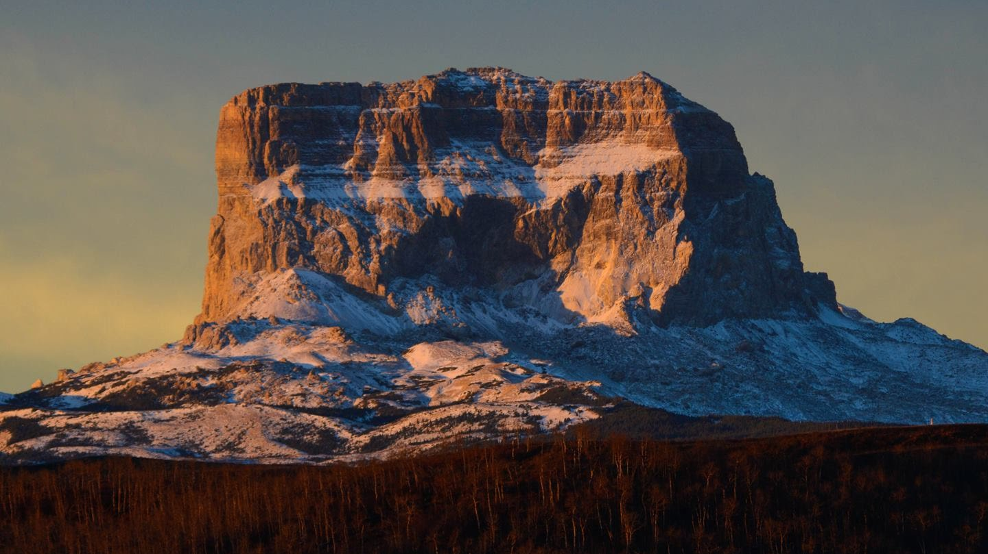

DISTRICT IEFA PLANNING AND REPORTING
ZACH HAWKINS
MIKE JETTY
OPI INDIAN ED. FOR ALL
NOVEMBER 13, 2023

Slide 8
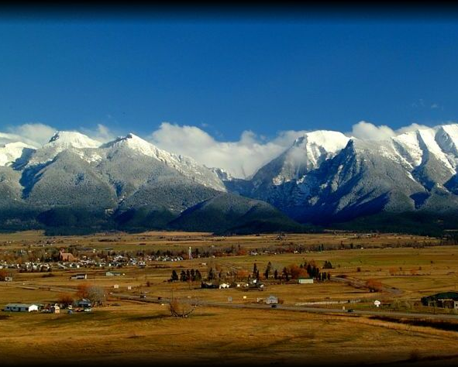
ARTICLE X OF THE MONTANA CONSTITUTION
EDUCATION AND PUBLIC LANDS (1972)
Section 1
(1) It is the goal of the people to establish a system
of education which will develop the full educational potential
of each person. Equality of educational opportunity is guaranteed
to each person of the state.
(2) The state recognizes the distinct and unique cultural heritage
of the American Indians and is committed in its educational
goals to the preservation of their cultural integrity.

Slide 9
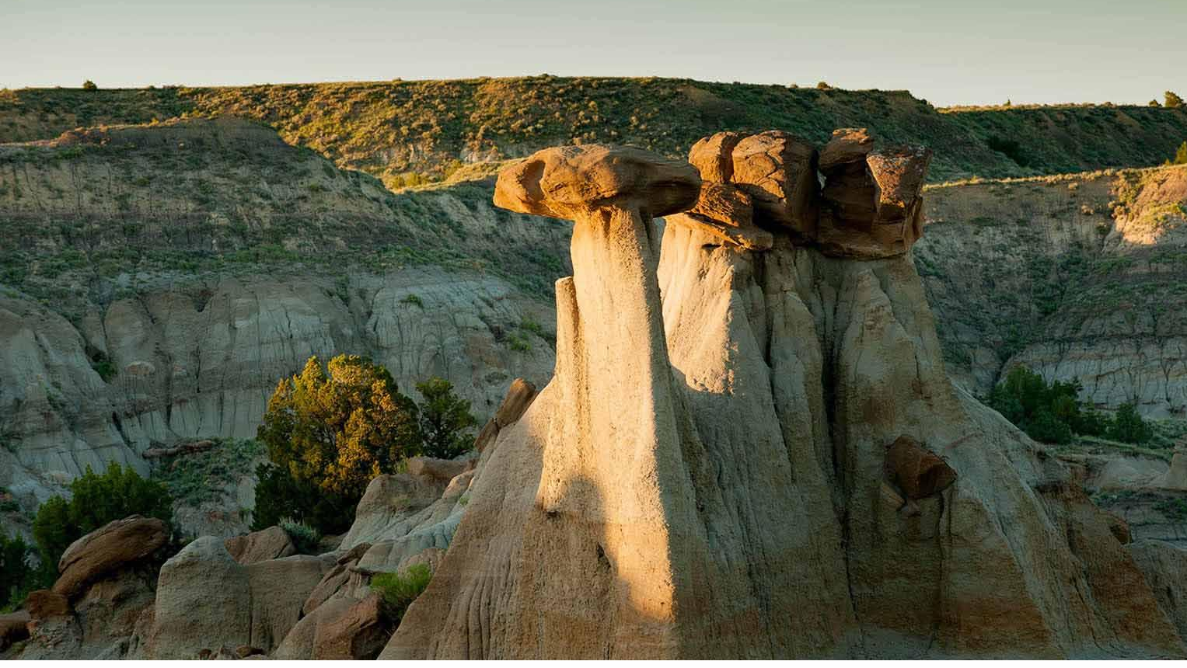
INDIAN EDUCATION FOR ALL (1999)
MCA 20-1-501
Every Montanan, whether Indian or non-Indian, be encouraged to learn about the distinct and unique heritage of American Indians in a culturally responsive manner.
…all school personnel should have an understanding and awareness of Indian tribes to help them relate effectively with Indian students and parents...

Slide 10
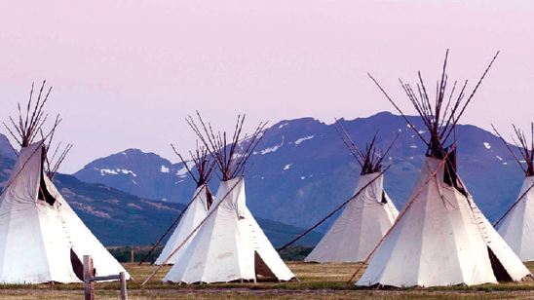
ACCREDITATION STANDARD
Policy for Indian Education for All:
10.55.901, 902, 904: Elementary, Middle Grades, and High School Programs:
…….must have an education program aligned to the program area standards that the content standards and content-specific grade-band learning progressions and recognizes the distinct and unique cultural heritages of American Indians.

Slide 11


ESSENTIAL UNDERSTANDINGS
EU 1: Tribal Diversity
EU 2: Individual Diversity
EU 3: Persistence of Spirituality and Beliefs. Oral Histories
EU 4: Treaty Process. Tribal and U.S. Government Roles
EU 5: Federal Policy Periods
EU 6: Historical Perspectives. Conflicting Narratives
EU 7: Sovereignty of Tribal Nations

Slide 12
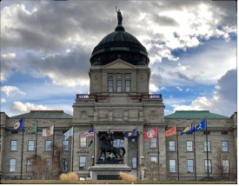
ANB FUNDING
The 2005 Legislature allocated funding for districts to implement IEFA in the amount of $20.40 per student.
Subsequent Legislatures have provided continued funding. Current amount is $23.28 per student or $100, whichever is greater.

Slide 13
HOW DO I SPEND MY IEFA FUNDING?
Language from HB 388
Section 4:
(4) (a) A public school district that receives an Indian education for all payment may not divert the funds to any purpose other than curriculum development of an American Indian studies program, providing curriculum and materials to students for the program, and providing training to teachers about the program's curriculum and materials.

Slide 14
IEFA ACROSS SCHOOL DISTRICTS
District Type X: Small or mid-sized school district located far from a reservation and serving very few or no American Indian Students | District Type Y: Large urban school district with many American Indian students representing many Montana Tribes | District Type Z: School districts located on or near a reservation and having a majority of American Indian students
Support Level 1: Essential Understandings infused into content areas Professional development on Essential Understandings, critical literacy, integration strategies, text selection to reduce bias Access to quality materials Periodic access to specialists Periodic inquiry-based depth of study units Professional development on equity pedagogy, anti-bias education and teacher expectations | Support Level 1: Essential Understandings infused into content areas Professional development on Essential Understandings, critical literacy, integration strategies, text selection to reduce bias Access to quality materials Periodic access to specialists Periodic inquiry-based depth of study units Professional development on equity pedagogy, anti-bias education and teacher expectations | Support Level 1: Essential Understandings infused into content areas Professional development on Essential Understandings, critical literacy, integration strategies, text selection to reduce bias Access to quality materials Periodic access to specialists Periodic inquiry-based depth of study units Professional development on equity pedagogy, anti-bias education and teacher expectations
 | Support Level 2: 9-12 Elective courses taught by specialists 5-8 Exploratory offerings in American Indian studies K-6 Inquiry based depth-of-study units. At least 1 annually at each grade level | Support Level 2: 9-12 Elective courses taught by specialists 5-8 Exploratory offerings in American Indian studies K-6 Inquiry based depth-of-study units. At least 1 annually at each grade level
 |  | Support Level 3: K-12 core curricular strand of American Indian Studies taught by specialists K-12 instruction in a tribal language

Slide 15
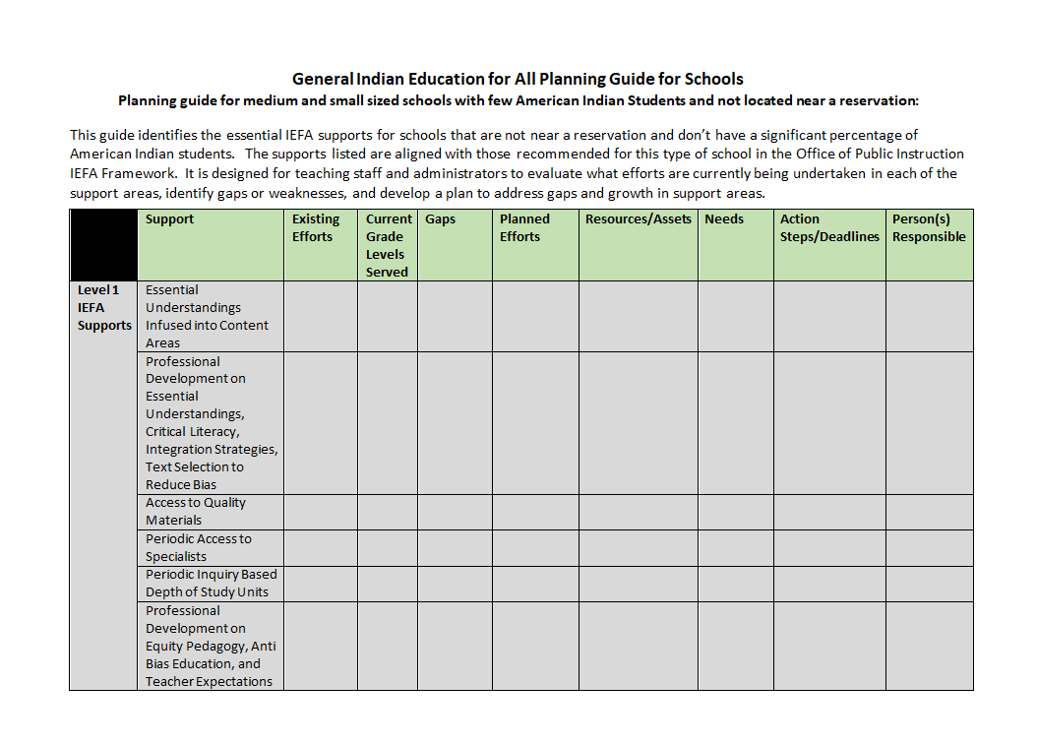
IEFA PLANNING GUIDES

Slide 16

SCHOOL DISTRICT COMPONENTS OF INDIAN EDUCATION FOR ALL
Policy and Planning
Professional Development
Materials Review and Selection
Curriculum Mapping
Curricular Integration

Slide 17
FRAMEWORK HUB COURSE PARTICIPANT RESPONSE
In what ways will utilization of the Framework help you better integrate IEFA into your curriculum and educational practices?
I think that breaking it down into something tangible and doable was a huge accomplishment. It made it feel less scary and “where to start” feeling for me. I no longer have this blank canvas. I know where to start and where to go from here.

Slide 18


WHAT ARE QUALITY IEFA MATERIALS?
Tribally Specific
Culturally Authentic
Historically Accurate
Contemporary Portrails

Slide 19
QUESTIONS TO ASK YOURSELF ABOUT POSSIBLE IEFA MATERIALS AND TEXTS
Does it promote a generic version of Indians or a vague tribal identity?
Does it mix and match cultural attributes from different tribes?
Does it promote stereotypes or caricatures of American Indian, people, tribes, or cultures?
Does it imply American Indian cultures are inferior or bad?
Does it provide only a non-Indian point of view of history or events?
Does it mention only American Indians who were useful to Europeans or Euro-Americans?

Slide 20
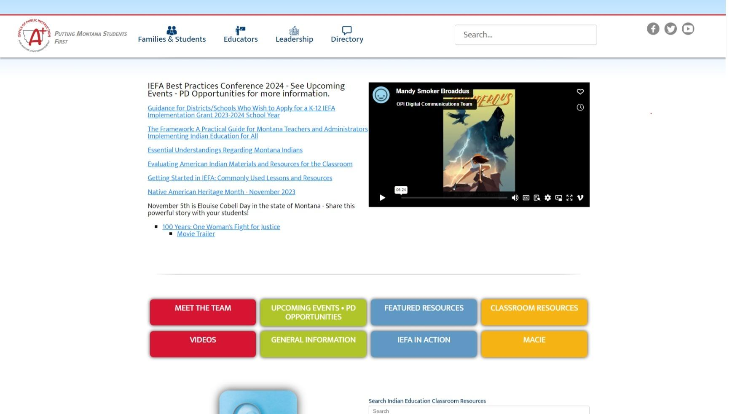
OPI IEFA WEB SITE

Slide 21
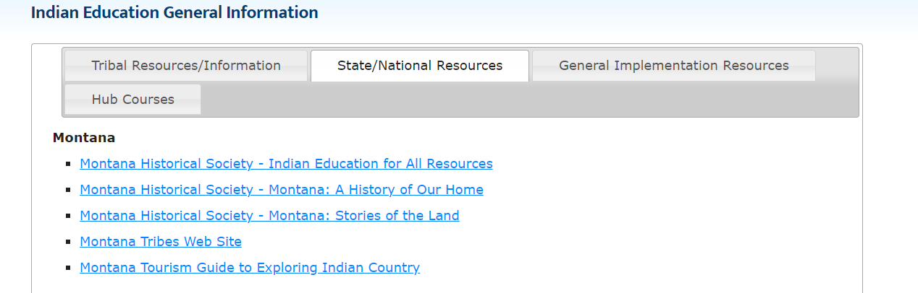
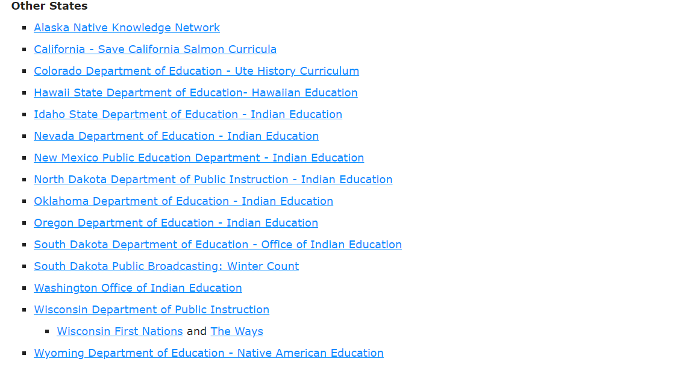
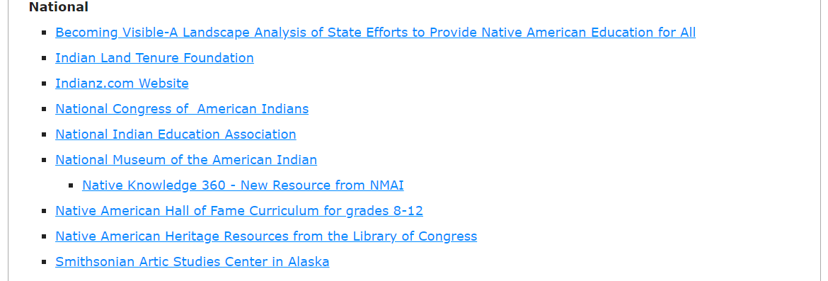
GENERAL INFORMATION PAGE

Slide 22


GENERAL IEFA AWARENESS RESOURCES AND IDEAS
Display Tribal Flags in School Common Area(s)
Montana Tribes Map
Essential Understandings Poster
Utilize OPI IEFA Poster Series
  Making Montana Proud
  Representation Matters

Slide 23
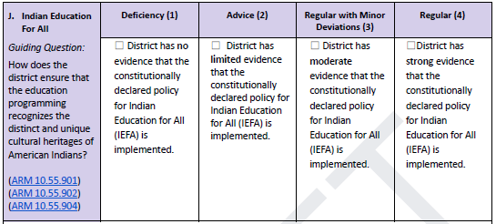
INTEGRATED STRATEGIC ACTION PLAN (ISAP)
IEFA REPORTING

Slide 24
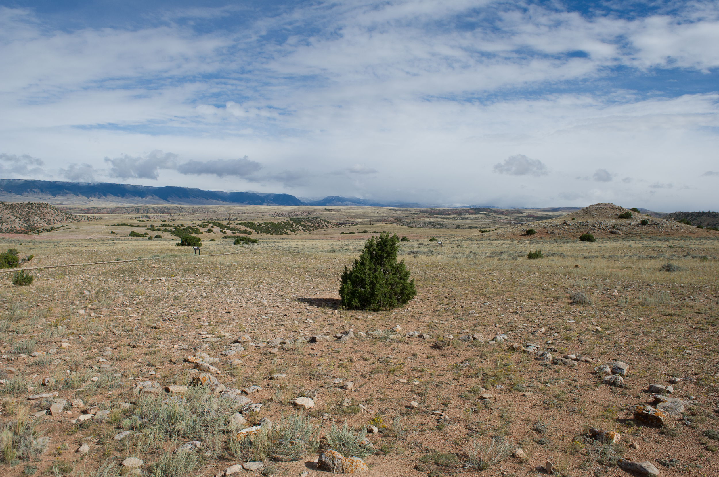
EXAMPLES OF EVIDENCE
Advice | Regular With Minor Deviations | Regular
District policy Special events. i.e. AI Heritage Day event, traditional games event, etc.. General statements without specifics or actual documents of evidence Evidence of school wide Indigenous awareness without curricular evidence | Limited curricular evidence provided Evidence of IEFA implementation at one or two grade bands but not all Citation or provision of one or two lessons Evidence of implementation but not across all grades and subjects Reference to or evidence of IEFA PD | Clear evidence of implementation across grade levels and subject areas. E.g. curriculum map, or list of lessons by grade and subject Direct evidence of PD impact on staff and follow through Evidence of IEFA impact on students. e.g. de-identified sample of student work Evidence that student IEFA knowledge is being assessed at grade levels Other direct evidence of student knowledge of the Essential Understandings

Slide 25

QUESTIONS??
Zach Hawkins zachariah.hawkins@mt.gov
406-444-0708
    Mike Jetty
    mjetty@mt.gov
    406-444-0720

Slide 26

QR Code to give feedback

Slide 27
Criteria Reference Guide in Rule
10.55.606 ACCREDITATION PROCESS
(1) Regular accreditation means the school has met the assurance standards and student performance standards as defined in ARM 10.55.606, and the Licensure Endorsement Requirements Related to Teaching Assignments. A copy of the Accreditation Status Criteria Reference Guide must be made publicly available by the Superintendent of Public Instruction.
(2) Regular with minor deviation accreditation means the school does not meet all the requirements of regular accreditation outlined in (1), as defined in the Accreditation Status Criteria Reference Guide, which must be made publicly available by the Superintendent of Public Instruction.
(3) A school with regular accreditation with a deviation in student performance standards, as defined in ARM 10.55.606, or regular with minor deviations accreditation, as defined in ARM 10.55.606, shall remedy the deviations within three years or will be reassigned to a lower category of accreditation.
(4) Advice accreditation means the school exhibits serious and/or numerous deviations from the standards. A copy of the Accreditation Status Criteria Reference Guide must be made publicly available by the Superintendent of Public Instruction.
(5) Deficiency accreditation means the school is in advice status for two years, has not complied with the required corrective plan, and continues to have serious and/or numerous deviations, or has substantially increased the seriousness of deviations over the previous year.

Slide 28
Criteria Reference Guide
This is what will be used for year 1 accreditation
Year 2 will look different and will be coming at a later date.
Accreditation Process website for updates and guidance documents
ISAP Template
Criteria Reference Guide

Slide 29
Student Performance
Student Performance in ARM
defined in ARM 10.55.602(48) “...means the measurement of student performance and proficiency on annual state level summative assessments and graduation rates used to determine the accreditation status of a school.”
ARM 10.55.606(3) “Student performance standards are comprised of measures required under ARM 10.56.101(3) and other measures described in the state accountability system, defined in ARM 10.55.602, recommended by the state superintendent and approved by the Board of Public Education.”
PK-2 Assurances only
10.55.606(4) “For schools with only combinations of grades PK-2, only the assurance standards shall be used to determine accreditation status, pursuant to ARM 10.55.605 Categories of Accreditation.”

Slide 30
Student Performance: Math & ELA
Criteria Reference Guide Part A (Math) and B (ELA):
Regular - School has provided strong evidence of the use of 1 or more well designed measurements for student learning and evidence that data generated from tool is used to improve teaching and learning. The data from the tool shows an increase in achievement.
Regular with Minor Deviations - School has provided moderate evidence of the use of 1 or more valid and reliable measurements for student learning. The data from the tool shows an increase in achievement.
Advice - School has provided limited evidence of the use of 1 or more valid and reliable measurements for student learning. The data from the tool does not show an increase in achievement.
Evidence:
Strong - Evidence of a valid and reliable measurement tool used. The data generated from the tool is used to improve teaching and learning and demonstrates an increase in student learning progression, growth, or proficiency with overall group performance.
Moderate - Evidence of a valid and reliable measurement but no evidence on how the measurement tool is used to improve teaching and learning. Data provided demonstrates an increase in student learning progression, growth, or proficiency.
Limited - Evidence of a valid and reliable measurement tool used but no evidence on how the data generated from the tool is used to improve teaching or learning or that data provided demonstrates an increase in student learning progression, growth, or proficiency with overall group performance data.

Slide 31
Student Performance: Math & ELA
Student Learning Outcomes - (School)
How is the school ensuring all students are learning in ELA? (Middle School and Elementary School)
Student Learning Outcomes - (School)
How is the school ensuring all students are learning in Math? (Middle School and Elementary School)
(Written Response) The school uses data from MAP testing, SBAC, and district assessments to ensure all students are learning in Math. The data acquired is used to generate domain specific intervention groups, and students are placed in the groups according to the weakest domain for each individual. MAP growth data is used to identify students who do not achieve at least one year’s growth in math. Individualized plans are made by the MTSS team, and the identified students are progress monitored to ensure growth. SBAC data is used to identify grade level areas that need improvement. The Curriculum and Instructional coaches work with the grade level teams on the areas identified to improve facilitation and student engagement.
(Written Response) The school uses data from AIMsweb, STAR, and MAP testing to ensure all students are learning in ELA. The data acquired is used to generate domain specific intervention groups, and students are placed in the groups according to the weakest area for each individual. MAP, AIMsweb, and STAR growth data is used to identify students who do not achieve at least one year’s growth in reading. Individualized plans are made by the MTSS team, and the identified students are progress monitored to ensure growth. SBAC data is used to identify grade level areas that need improvement. The Curriculum and Instructional coaches work with the grade level teams on the areas identified to improve facilitation and student engagement.
Choose File
No file chosen
Upload
Choose File
No file chosen
Upload
Growth Report Example 1
Growth Report Example 2
Proficiency Report Example 1

Slide 32
Student Performance: College & Career
Criteria Reference Guide Part C:
Regular - School has strong evidence to ensure students are graduating ready for college and/or career opportunities.
Regular with Minor Deviations - School has moderate evidence to ensure students are graduating ready for college and/or career opportunities.
Advice - School has limited evidence to ensure students are graduating ready for college and/or career opportunities.
Evidence:
Strong - submits 3 or more pieces of documentation
Moderate - submits at least 2 pieces of documentation
Limited - submits at least 1 piece of documentation

Slide 33
Student Performance: College & Career
College and Career Readiness - (School)
How is the school ensuring that students graduate college and career ready?(High School)
(Written Response) The school utilizes the Montana Ready Regional Career Coach and the Partners-In Education program to identify community partners and opportunities for career exploration. The school has provided counseling services on post-grad pathways. The Career Fair exposed students to military recruiters, 25 occupational and business representatives, and four colleges and trade schools. MTDA and Dual Credit courses provided personalized instruction for 55% of the sophomore, junior, and senior students.
Choose File
No file chosen
Upload
ACT College and Career Readiness
ACT CCR Aspirations

Slide 34
Professional Development
NOVEMBER
29th 1:30- 3:00* | Graduate Profile | Virtual
JANUARY
25th TBD | Family and Community Engagement | Virtual
FEBRUARY
1st 12:00- 1:30 | The New Accreditation Tool | Virtual
2nd 9:00- 10:30
20th- 22nd 9:00- 12:00 & 1:00- 4:00 | Work Sessions | Virtual
26th 9:00- 3:00 | Work Session | Billings
28th TBD | Work Session | Missoula
29th 9:00- 3:00 | Work Session | Helena
MARCH
1st TBD | Work Session | Havre

Slide 35
How to Connect with Us?
Virtual Office Hours via Zoom
  Tuesdays 3:00 - 4:00
  https://mt-gov.zoom.us/j/85904973164?pwd=V2JGbGFoNE1rVmx3Z29mVUJwKy9xdz09
Professional Development Sessions
  See previous slide
Email
  OPIACCRED@mt.gov
Webpage
  https://opi.mt.gov/Leadership/Assessment-Accountability/School-Accreditation
Notes:
Show Webpage https://opi.mt.gov/Leadership/Assessment-Accountability/School-Accreditation
Demonstration Example: Demonstration Example

Slide 36
Questions?

Slide 37

End

